Slide 1

Algebra 1
Unit 4, Lesson 8 Comparing Linear Functions Volume 1, pg. 201

Slide 2


Benchmark
MA.912.F.1.5
Compare key features of linear functions each represented algebraically, graphically, in tables, or written descriptions.
volume 1, pg. 201

Slide 3
Integrated Mathematical Thinking and Reasoning Standards
MA.K12.MTR.1.1 Actively participate in effortful learning both individually and collectively.
MA.K12.MTR.2.1 Demonstrate understanding by representing problems in multiple ways.
MA.K12.MTR.4.1 Engage in discussions that reflect on the mathematical thinking of self and others.
MA.K12.MTR.6.1 Assess the reasonableness of solutions.
MA.K12.MTR.7.1 Apply mathematics to real-world contexts.
volume 1, pg. 201

Slide 4

Learning Target
I can compare key features of linear functions.
volume 1, pg. 201

Slide 5

Warm-Up
volume 1, pg. 202

Slide 6
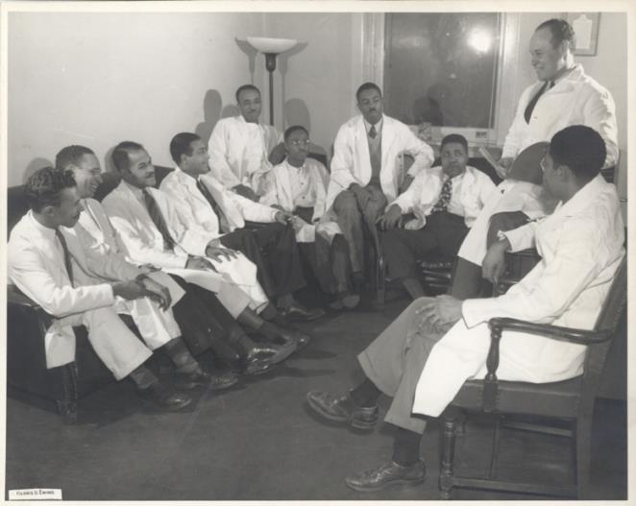
4.8.1 Warm-Up: Blood Donation
Dr. Charles Drew, a pioneering African American medical researcher, discovered a way to store and process blood for transfusions. Dr. Drew managed two of the largest blood banks in the world during World War II as the medical director of the Red Cross National Blood Donor Service, collecting tens of thousands of pints of blood for U.S. soldiers. It has been said that Dr. Drew’s research and work saved the world against Nazism, as battlefield blood storage and transfusions did not exist before.
volume 1, pg. 202
Notes:
Video Link: https://algebranation.wistia.com/medias/fi4fidi5y8

Slide 7
After a ruling stated that the blood from African-Americans could not be transfused to white soldiers, Dr. Drew resigned from the Red Cross and became a professor at Howard University’s medical school (an HBCU), training a generation of black physicians on the research of storing and collecting blood.
volume 1, pg. 202

Slide 8
The graph shows the relationship between pints of blood collected and the number of donors according to the Red Cross in the U.S. today.
Pints of Blood Donated
Number of Donors
volume 1, pg. 202

Slide 9
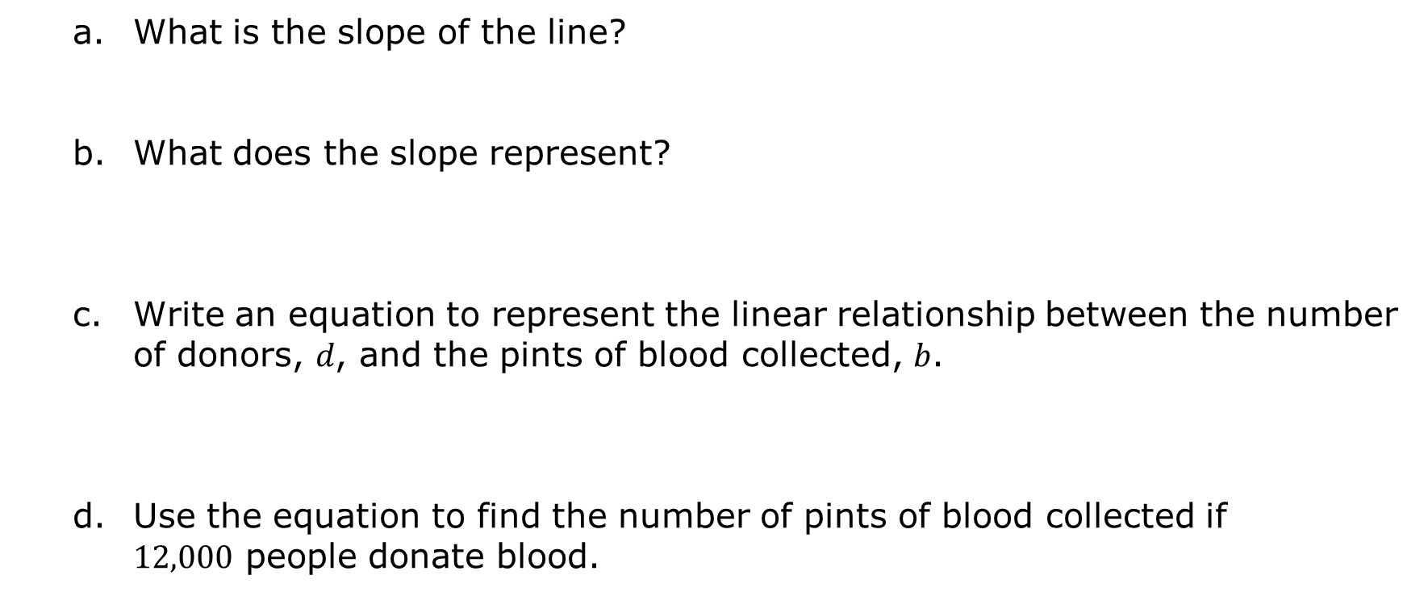
What is the slope of the line?
What does the slope represent?
Write an equation to represent the linear relationship between the number of donors, 𝑑, and the pints of blood collected, 𝑏.
Use the equation to find the number of pints of blood collected if $12,000$ people donate blood.
volume 1, pg. 202

Slide 10

Collaboration
volume 1, pg. 203

Slide 11

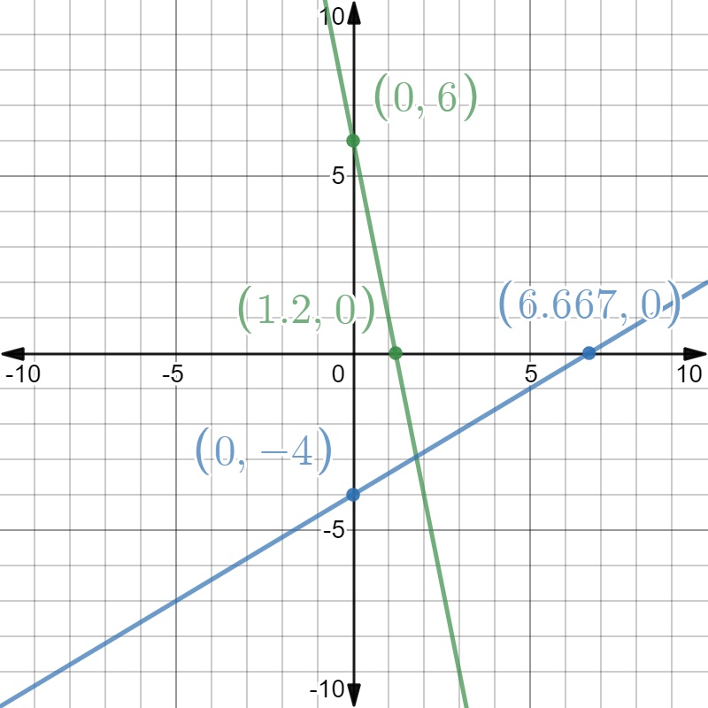
4.8.2 Collaboration: Comparing Representations of Linear Functions
Two linear functions are shown on the coordinate grid.
volume 1, pg. 203

Slide 12
Which line has the larger 𝑥-intercept?
Which line has the smaller 𝑦-intercept?
Which line has the larger slope?
For which line does 𝑦 decrease as 𝑥 increases?
volume 1, pg. 203

Slide 13
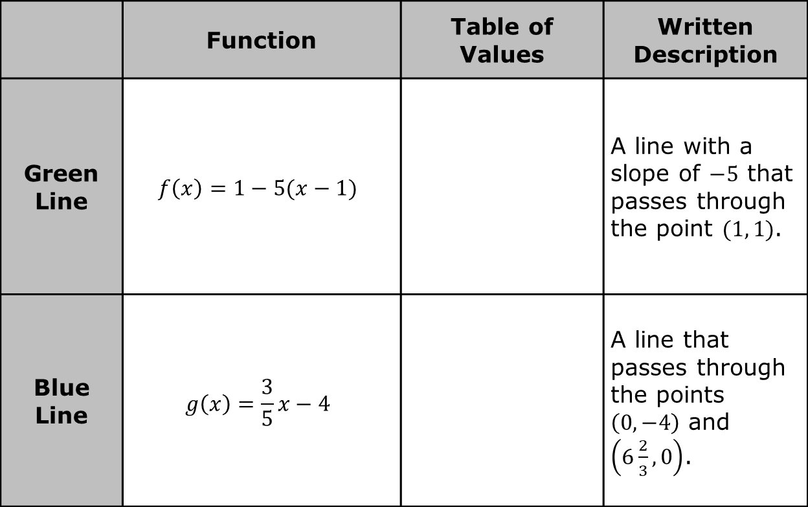
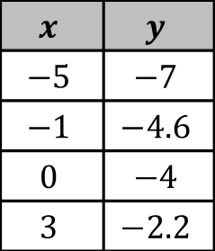
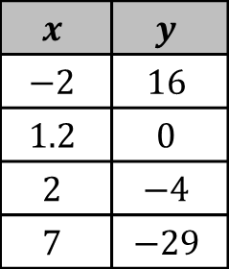
The table shows other ways the linear relationships could be represented.
 | Function | Table of Values | Written Description
Green Line | $$f\left(x\right)=1−5(x−1)$$ |  | A line with a slope of $−5$ that passes through the point $(1, 1)$.
Blue Line | $$g\left(x\right)=\frac{3}{5}x−4$$ |  | A line that passes through the points $\left(0, −4\right)$ and $\left(6\frac{2}{3}, 0\right)$.
$$x$$ | $$y$$
$$−2$$ | $$16$$
$$1.2$$ | $$0$$
$$2$$ | $$−4$$
$$7$$ | $$−29$$
$$x$$ | $$y$$
$$−5$$ | $$−7$$
$$−1$$ | $$−4.6$$
$$0$$ | $$−4$$
$$3$$ | $$−2.2$$
volume 1, pg. 203

Slide 14
With your partner, discuss which representation(s) of the green line can be used to determine the 𝑥‑intercept.
With your partner, discuss which representation(s) of the blue line can be used to determine the 𝑦‑intercept.
volume 1, pg. 203

Slide 15
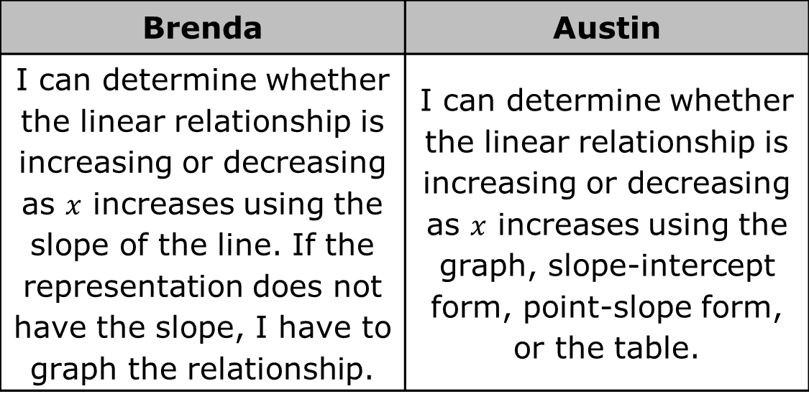
Brenda and Austin were discussing the representations of the blue and green line.
Brenda | Austin
I can determine whether the linear relationship is increasing or decreasing as $x$ increases using the slope of the line. If the representation does not have the slope, I have to graph the relationship. | I can determine whether the linear relationship is increasing or decreasing as $x$ increases using the graph, slope-intercept form, point-slope form, or the table.
volume 1, pg. 204

Slide 16
With your partner, discuss how Brenda can determine if a linear relationship is increasing or decreasing using only the slope of the line. Write a summary of your discussion.
With your partner, discuss how Austin could use a table to determine if a linear relationship is increasing or decreasing. Write a summary of your discussion.
volume 1, pg. 204

Slide 17
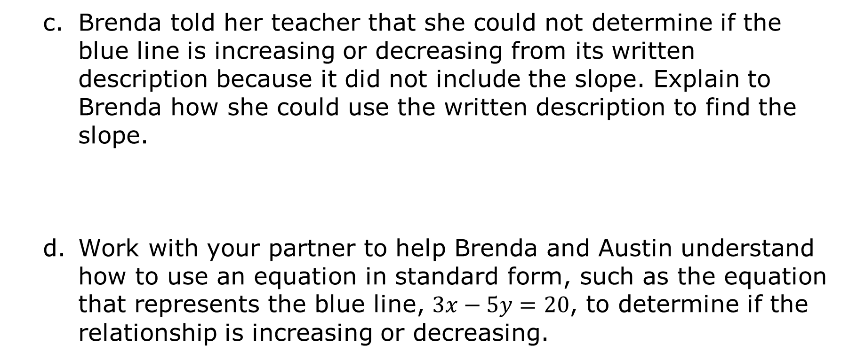
Brenda told her teacher that she could not determine if the blue line is increasing or decreasing from its written description because it did not include the slope. Explain to Brenda how she could use the written description to find the slope.
Work with your partner to help Brenda and Austin understand how to use an equation in standard form, such as the equation that represents the blue line, $3x−5y=20$, to determine if the relationship is increasing or decreasing.
volume 1, pg. 204

Slide 18

Guided Instruction
volume 1, pg. 205

Slide 19

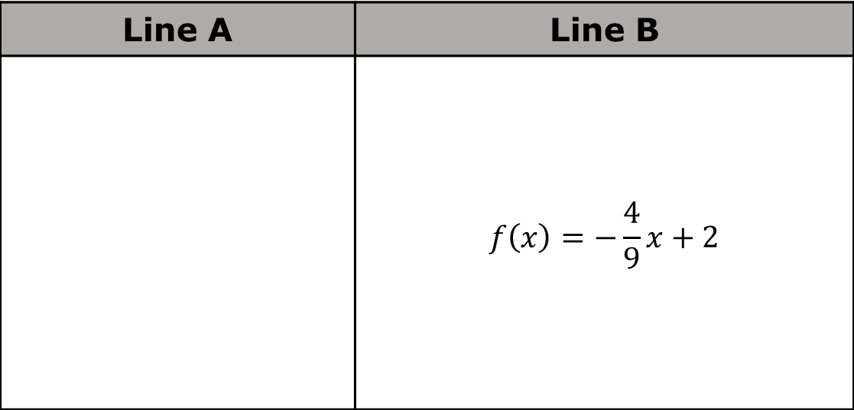
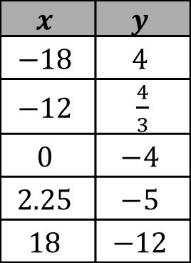
4.8.3 Guided Instruction: Comparing End Behavior
Two different linear functions are shown.
Line A | Line B
 | $$f\left(x\right)=−\frac{4}{9}x+2$$
$$x$$ | $$y$$
$$−18$$ | $$4$$
$$−12$$ | $\frac{4}{3}$
$$0$$ | $$−4$$
$$2.25$$ | $$−5$$
$$18$$ | $$−12$$
volume 1, pg. 205

Slide 20
Which linear relationship has the smaller 𝑦‑intercept?
Compare the domains of the two linear relationships.
volume 1, pg. 205

Slide 21
Determine which linear relationship has the larger slope.
Determine if line A is increasing or decreasing as 𝑥 increases. Show your work or explain your thinking.
Determine if line B is increasing or decreasing as 𝑥 increases. Show your work or explain your thinking.
volume 1, pg. 205

Slide 22
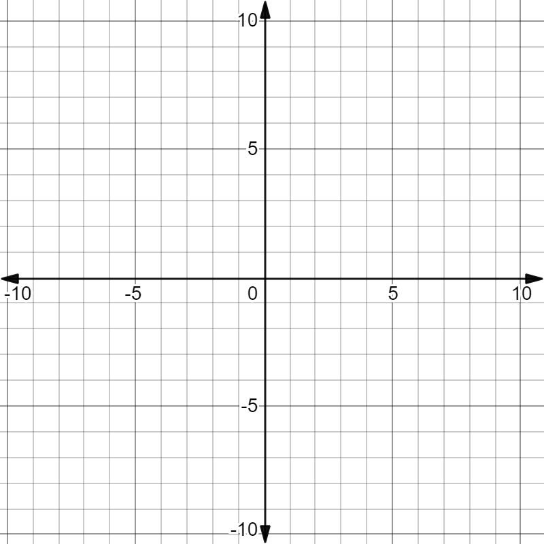
Sketch and label the graph of each linear relationship on the coordinate grid.
volume 1, pg. 205

Slide 23
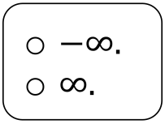
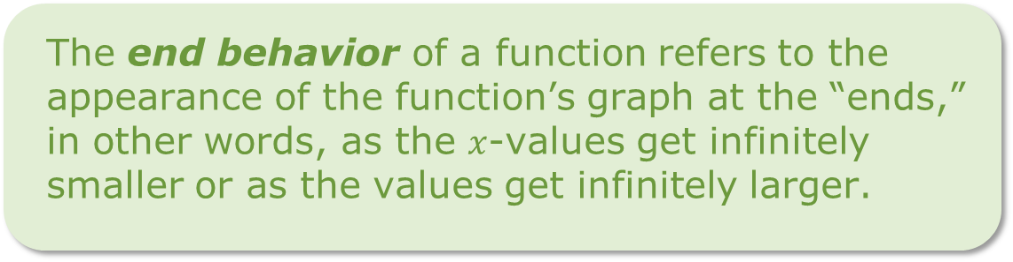
Use the definition of end behavior to complete the sentences.
For line A, as the 𝑥-values get smaller, the appearance of the graph of A approaches
For line A, as the 𝑥-values get larger, the appearance of the graph of A approaches
The end behavior of a function refers to the appearance of the function’s graph at the “ends,” in other words, as the $x$-values get infinitely smaller or as the values get infinitely larger.
volume 1, pg. 206

Slide 24
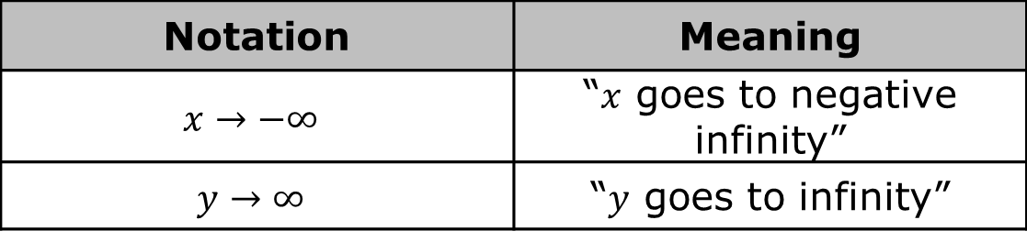
Another way to represent end behavior is to use mathematical notation. Two examples are shown in the table.
Complete the mathematical notation for end behavior for line B.
Notation | Meaning
$$x→−∞$$ | “$x$ goes to negative infinity”
$$y→∞$$ | “$y$ goes to infinity”
As $x→−∞$, $y→_______$. | As $x→∞$, $y→_______$.
volume 1, pg. 206

Slide 25

Your Turn
volume 1, pg. 206

Slide 26
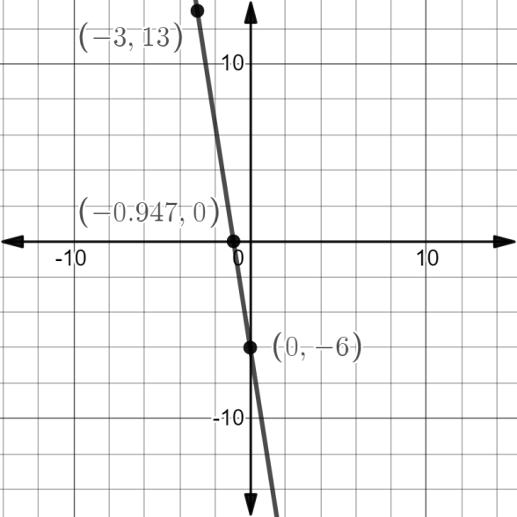
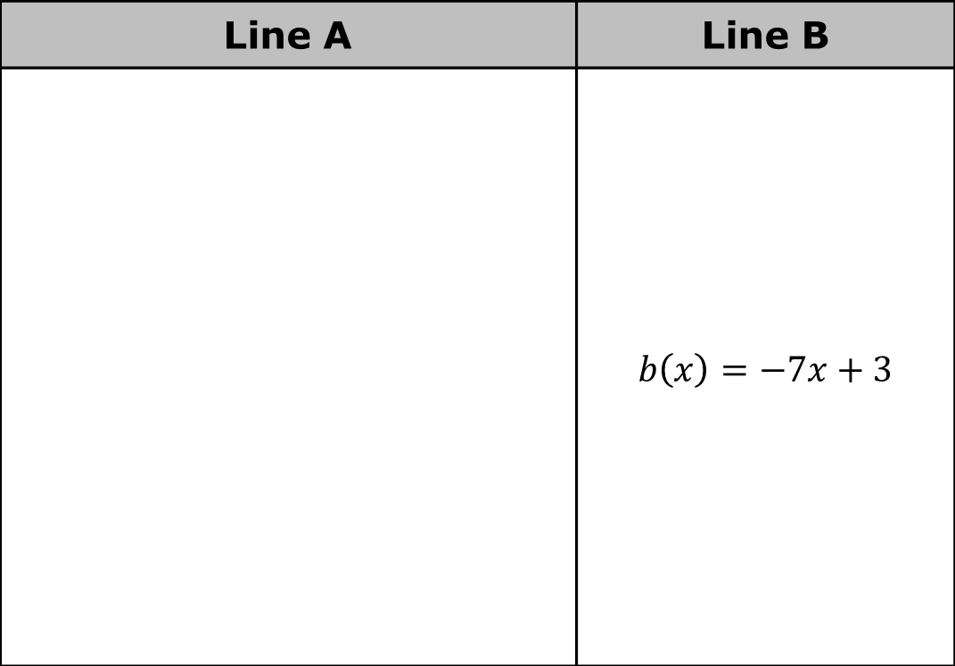
4.8.4 Your Turn!
Two different linear functions are shown.
Line A | Line B
 | $$b\left(x\right)=−7x+3$$
volume 1, pg. 206

Slide 27
Name the key feature(s) that are the same for both linear functions.
Give the key feature(s) that are different for the functions.
volume 1, pg. 206

Slide 28
Which linear function has the smaller slope?
Which linear function has the larger 𝑥-intercept?
volume 1, pg. 207

Slide 29

Wrap-Up
volume 1, pg. 207

Slide 30



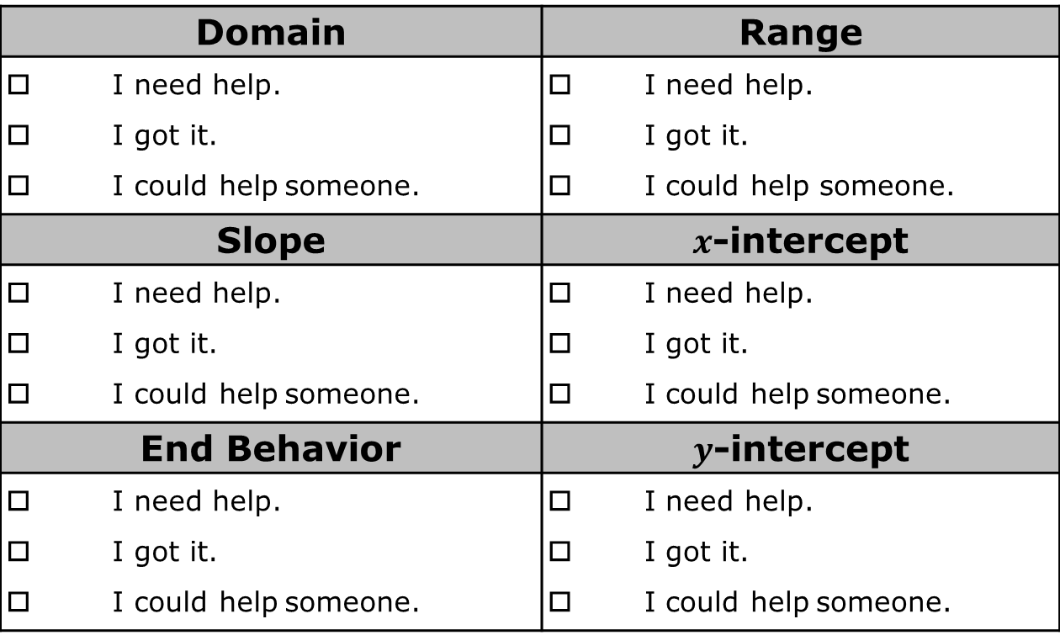
4.8.5 Wrap-Up: Reflection
Complete the table to describe your understanding of each key feature.
Domain | Range
I need help. I got it. I could help someone. | I need help. I got it. I could help someone.
Slope | $x$-intercept
I need help. I got it. I could help someone. | I need help. I got it. I could help someone.
End Behavior | $y$-intercept
I need help. I got it. I could help someone. | I need help. I got it. I could help someone.
volume 1, pg. 207

